Slide 1
Introduction to Operating Systems

Slide 2
What Is an Operating System?
Some years ago an operating system was defined as the software that controls the hardware.
Landscape of computer systems has evolved significantly, requiring a more complicated definition.
Applications are now designed to execute concurrently.

Slide 3
What Is an Operating System?
Separates applications from the hardware they access
Software layer
Manages software and hardware to produce desired results
Operating systems primarily are resource managers
Hardware
Processors
Memory
Input/output devices
Communication devices
Software applications

Slide 4
Early History: The 1940s and 1950s
Operating systems evolved through several phases
1940s
Early computers did not include operating systems
1950s
Executed one job at a time
Included technologies to smooth job-to-job transitions
Single-stream batch-processing systems
Programs and data submitted consecutively on tape

Slide 5
The 1960s
1960s
Still batch-processing systems
Process multiple jobs at once
Multiprogramming
One job could use processor while other jobs used peripheral devices
Advanced operating systems developed to service multiple interactive users
1964
IBM announced System/360 family of computers

Slide 6
The 1960s
Timesharing systems
Developed to support many simultaneous interactive users
Turnaround time was reduced to minutes or seconds
Time between submission of job and the return of its results
Real-time systems
Supply response within certain bounded time period
Improved development time and methods
MIT used CTSS system to develop its own successor, Multics
TSS, Multics and CP/CMS all incorporated virtual memory
Address more memory locations than actually exist

Slide 7
The 1970s
Primarily multimode timesharing systems
Supported batch processing, timesharing and real-time applications
Personal computing only in incipient stages
Fostered by early developments in microprocessor technology
Department of Defense develops TCP/IP
Standard communications protocol
Widely used in military and university settings
Security problems
Growing volumes of information passed over vulnerable communications lines.

Slide 8
The 1980s
1980s
Decade of personal computers and workstations
Computing distributed to sites at which it was needed
Personal computers proved relatively easy to learn and use
Graphical user interfaces (GUI)
Transferring information between computers via networks became more economical and practical

Slide 9
The 1980s
Client/server computing model became widespread
Clients request various services
Servers perform requested services
Software engineering field continued to evolve
Major thrust by the United States government aimed at tighter control of Department of Defense software projects
Realizing code reusability
Greater degree of abstraction in programming languages
Multiple threads of instructions that could execute independently

Slide 10
2000 and Beyond
Middleware
Links two separate applications
Often over a network and between incompatible machines
Particularly important for Web services
Simplifies communication across multiple architectures
Web services
Encompass set of related standards
Ready-to-use pieces of software on the Internet
Enable any two applications to communicate and exchange data

Slide 11
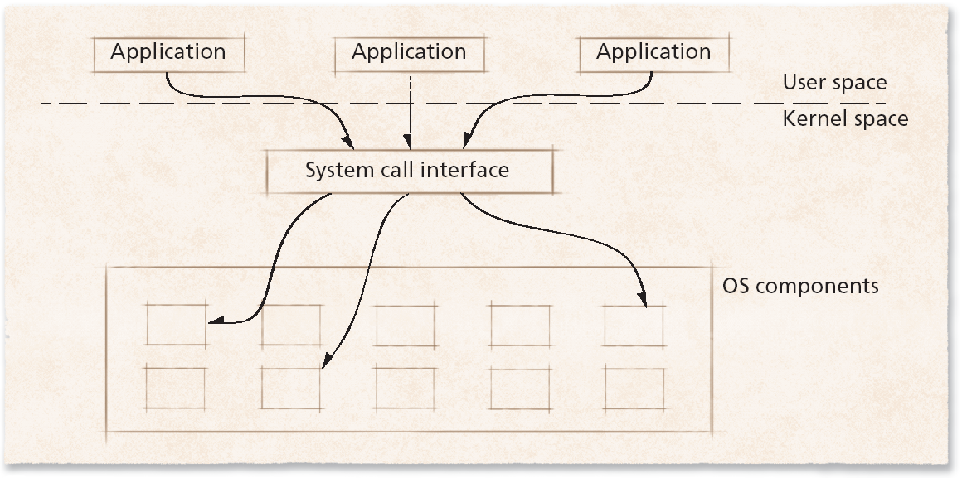
Application Bases
Figure 1.1 Interaction between applications and the operating system.

Slide 12
Operating System Environments
Operating systems intended for high-end environments
Special design requirements and hardware support needs
Large main memory
Special-purpose hardware
Large numbers of processes
Embedded systems
Characterized by small set of specialized resources
Provide functionality to devices such as cell phones and PDAs
Efficient resource management key to building successful operating system

Slide 13
Operating System Environments
Real-time systems
Require that tasks be performed within particular (often short) time frame
Autopilot feature of an aircraft must constantly adjust speed, altitude and direction
Such actions cannot wait indefinitely—and sometimes cannot wait at all

Slide 14
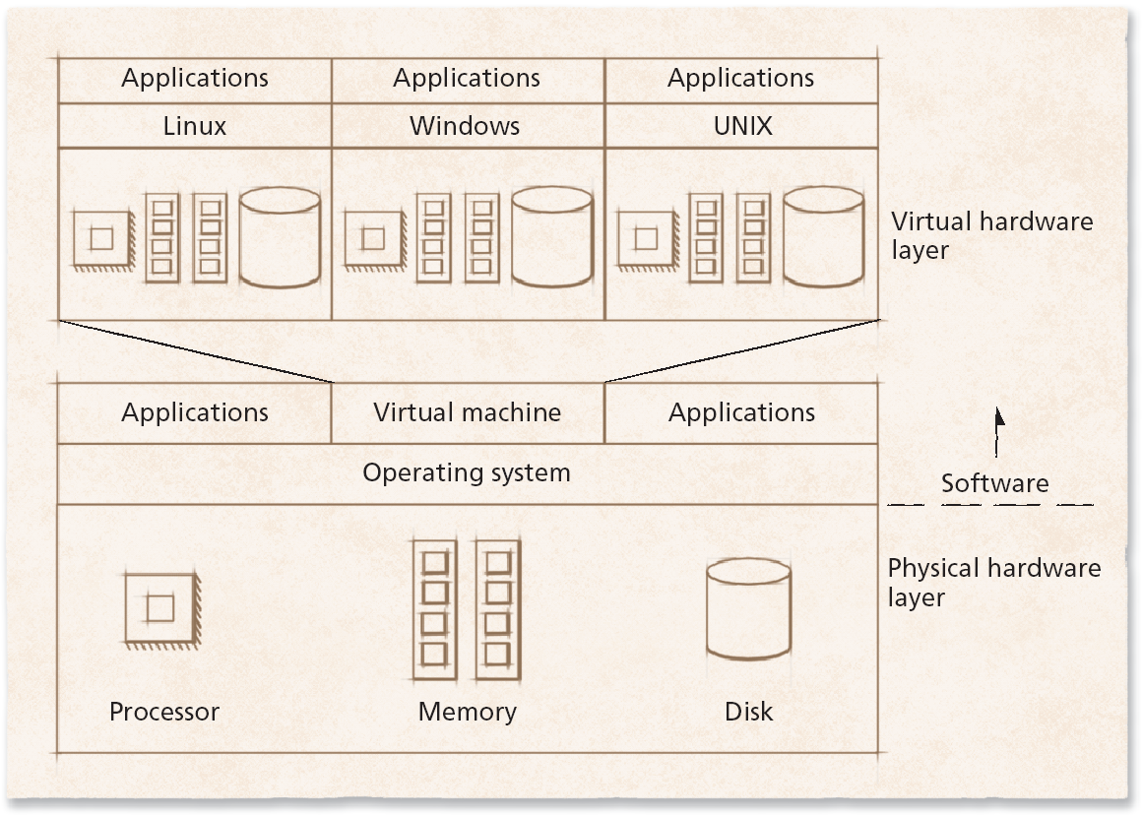
Operating System Environments
Figure 1.2 Schematic of a virtual machine.

Slide 15
Core Operating System Components
User interaction with operating system
Often, through special application called a shell
Kernel
Software that contains core components of operating system
Typical operating system components include:
Processor scheduler
Memory manager
I/O manager
Interprocess communication (IPC) manager
File system manager

Slide 16
Core Operating System Components
Multiprogrammed environments now common
Kernel manages the execution of processes
Program components which execute independently but use single memory space to share data are called threads.
To access I/O device, process must issue system call
Handled by device driver
Software component that interacts directly with hardware
Often contains device-specific commands

